Slide 1
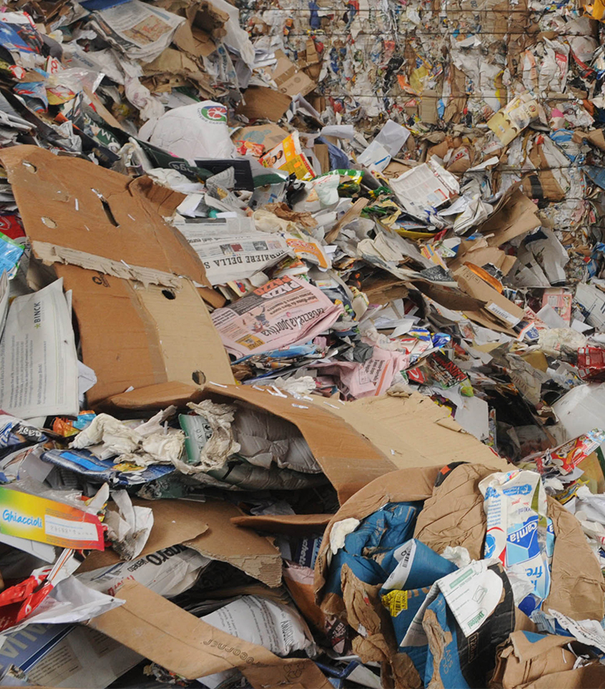
CSE3330 Spring 2020 Project 2: Online Return Induced Trash [1] University of Texas, Arlington Professor: Bhanu Jain TA’s Yash Dhani Spardha Gupta by Shameen Shetty, Bigyan Adhikari, Pawan Adhikari, Andrew Chanthamany
https://www.bbcearth.com/blog/%3Farticle%3Dyour-brand-new-returns-end-up-in-landfill/
How brand-new returns end up being thrown into landfills.
Photo from BBC-earth article, “Your brand-new returns end up in landfill”

Slide 2
Trash Problem
5 billion pounds of returned items end up in the trash heap [2]
Every year, consumers return about $380 billion worth of goods
Only half of returns make it back to shelves
The rest of the items that can’t be returned are simply dumped into landfills.^{[1]}
Why we chose this domain : In the next several years, as e-commerce grows globally, “the amount of returns is going to be over a trillion dollars a year,” Tobin Moore, the CEO of Optoro said.^{[3]}

Slide 3
How we can alleviate this trash problem
In order to solve this trash problem, we created a company ‘CheapOShop’ and will collaborate with Casella. Our company connects to online sellers and accept their return items in our inventory. We will apply different strategies to resell them again.
Encourage people to reduce their consumption so that they will not buy items that they do not need.
Provide a service from our company – we will collect online trash from retailers and customers free of cost, and either recycle it or repurpose it by using it as raw materials in mattresses or paper, or other industries.
Provide online inventory of the items we have, so that people can view the items and buy what they really need.
Anything that can not be recycled or given away to people, we can simply use as a raw material. This covers all the cases.

Slide 4
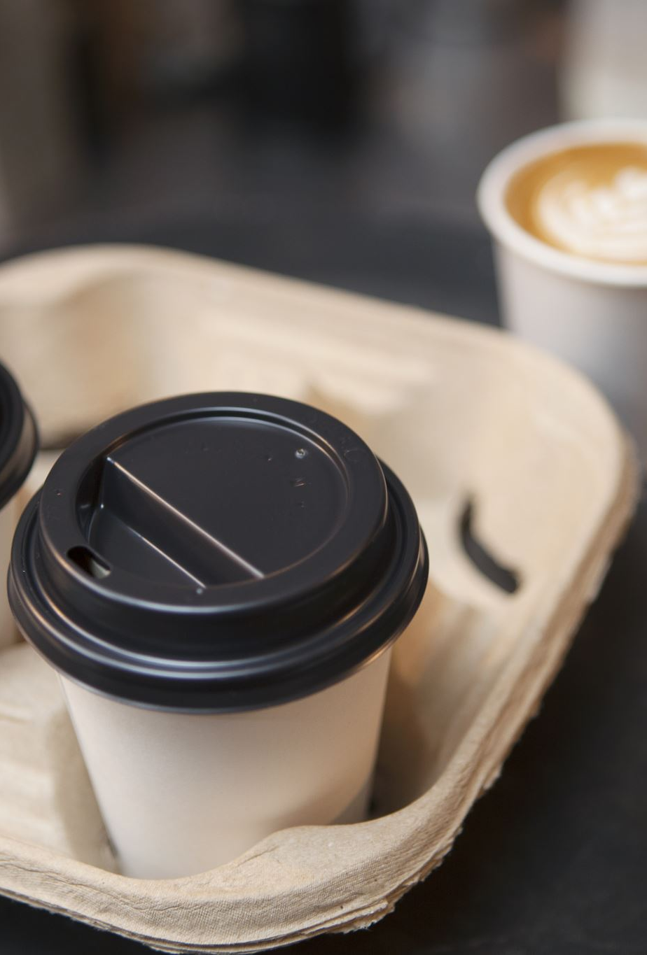
What we learnt from this project
How much of a problem online-returned trash is, and the effects that it has.
What we can do to solve this problem
Reduce our consumption
Recycle clothes or items not needed. CheapOShop helps solves this problem, by taking the clothes used and utilizing it instead of throwing it away. Collect trash from online retailers free of cost, and reuse and repurpose it for clothing, or raw materials used for paper, furniture, mattresses, etc.
Provide online inventory so that people can see what they need, and buy it
Finally, donate the left-over items to people who need them, or use the left-over clothes as raw materials instead.

Slide 5
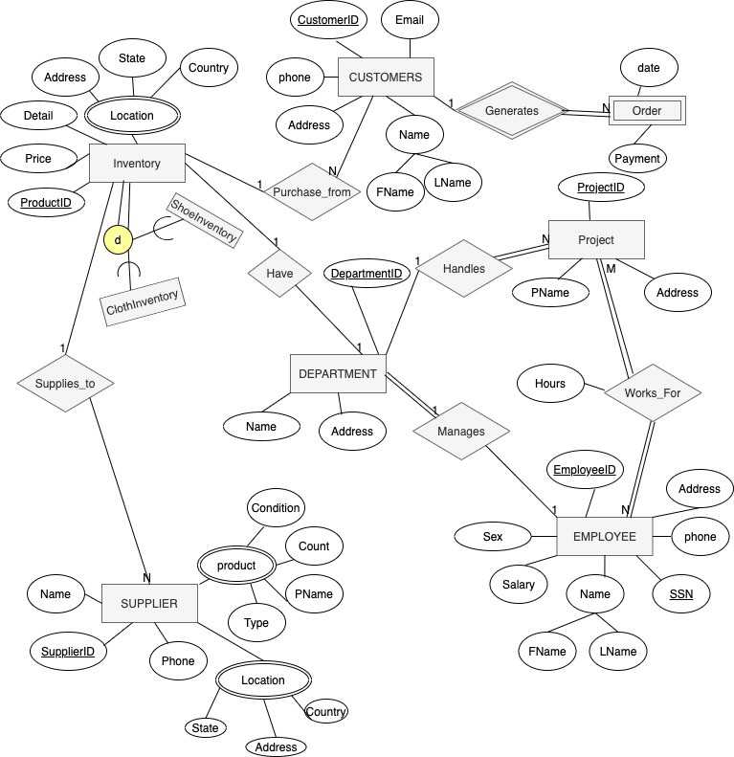
ER Schema Diagram

Slide 6
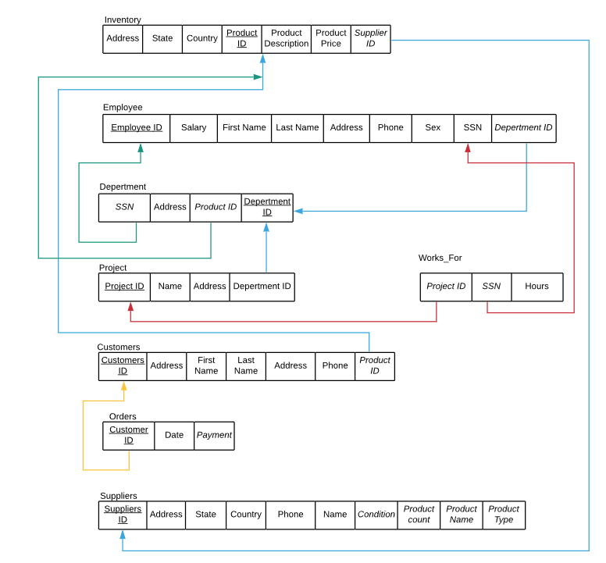
Relational Schema
Underlined : Primary
Attribute 1) Italics: foreign/ reference keys
2) 1:1 green 3) 1:N blue 4) N:M Red

Slide 7
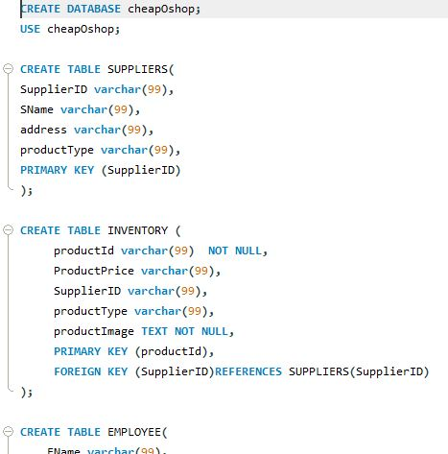

Slide 8
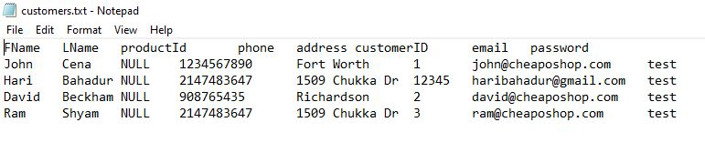
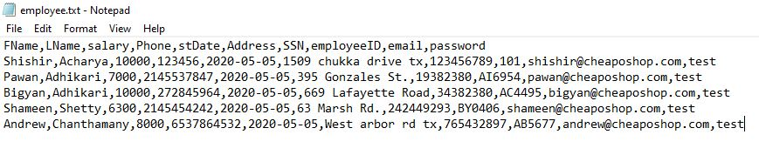
Dummy Data to populate our MySQL Database

Slide 9
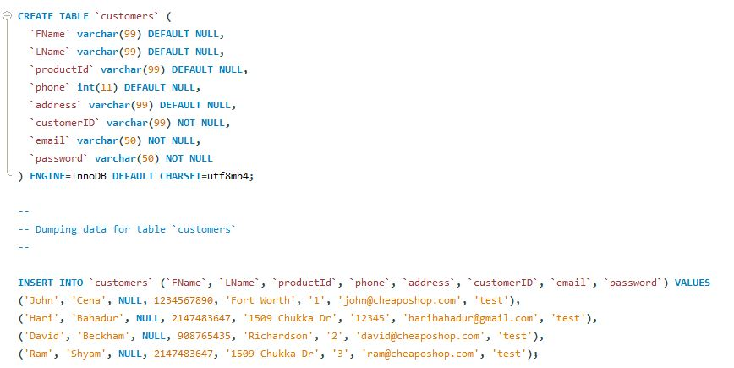
Populating our Database
It was imported from the .txt files

Slide 10
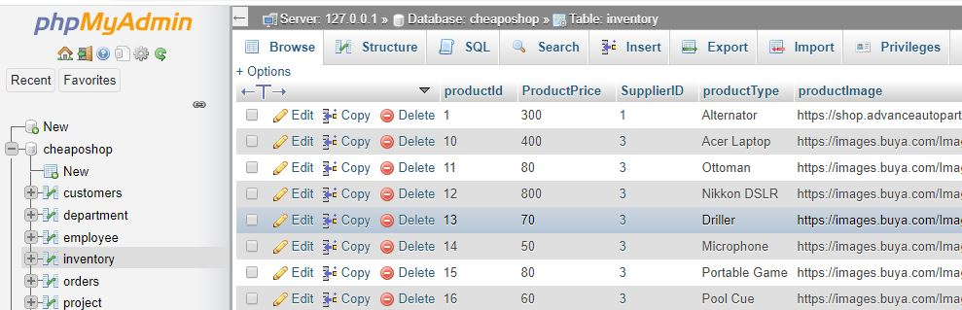
Database example with it’s tables

Slide 11
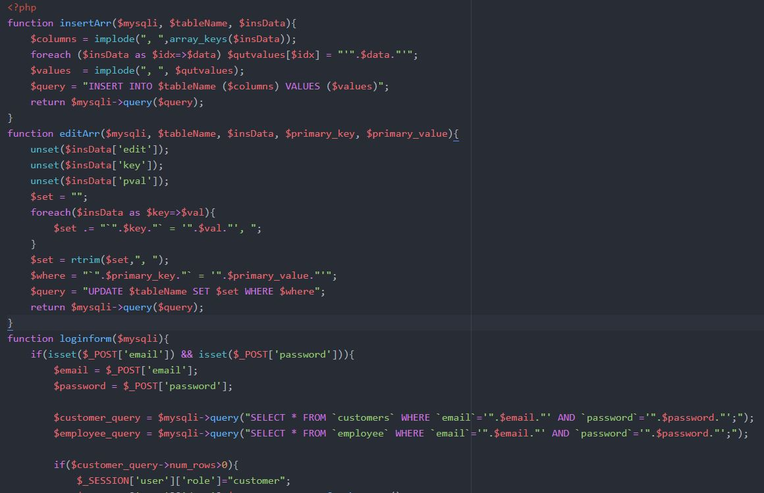
SQL queries in php -This is a dynamic query which will run according to the user choice and input

Slide 12
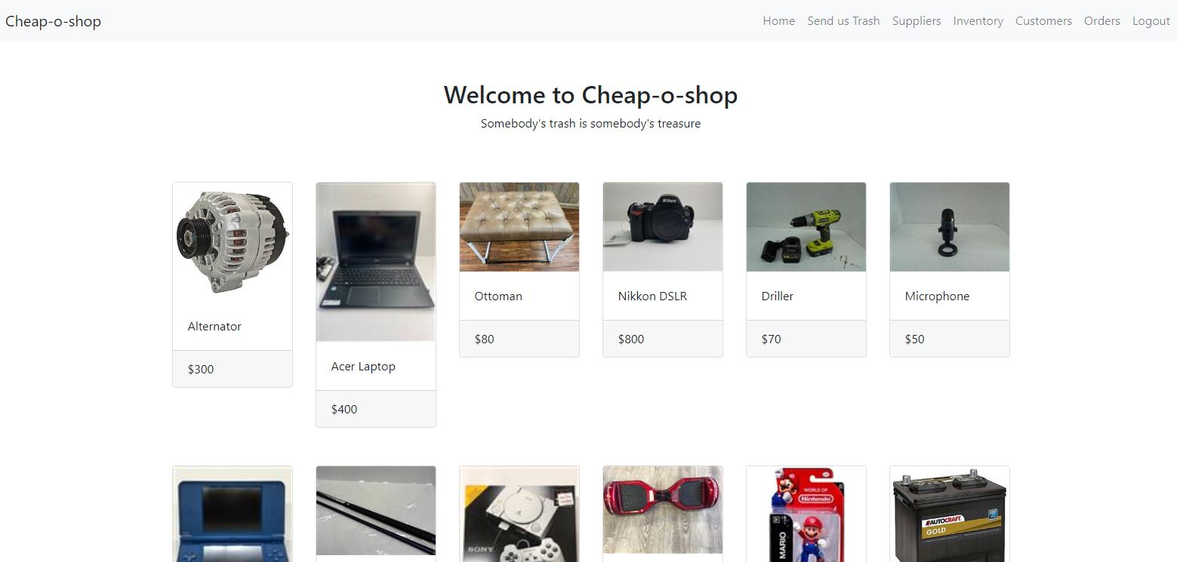
Web Interface: CheapOShop Home Page

Slide 13
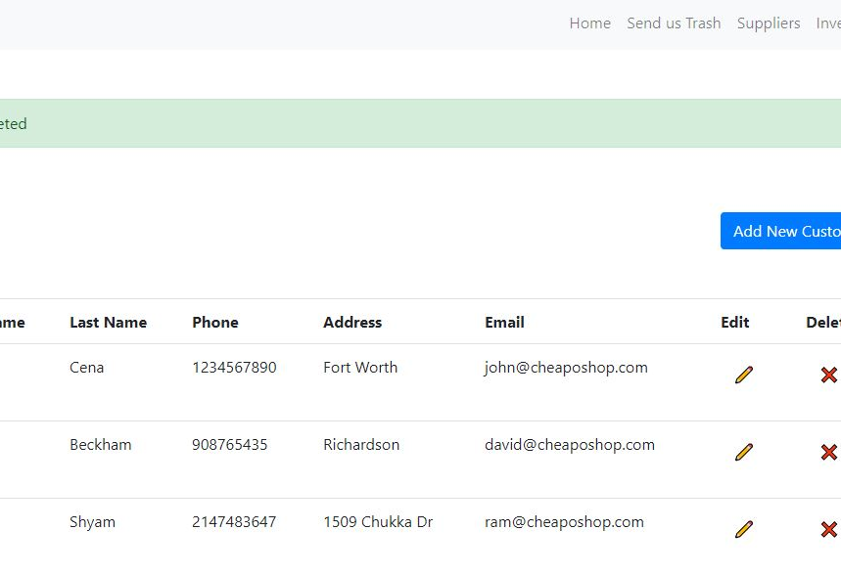
Adding Customer Data

Slide 14
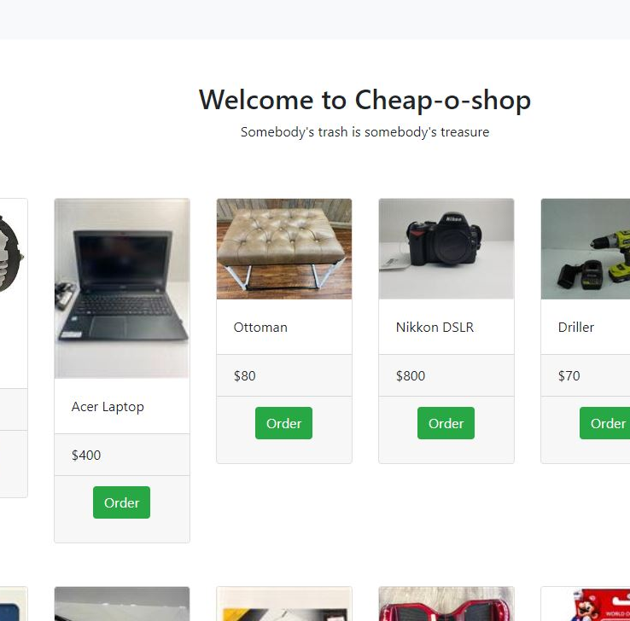
Customer Home-Page where they can buy used items from CheapOShop

Slide 15
Web Interface Explanation
Our website shows potential customers our online inventory, which means they can look for items that they need, and thus reduces any chance of the item being returned or thrown away.
The database helps our business requirements as it stores all relevant data – Employees, Customers, Inventory, etc.
The website also allows for potential retailers to learn how we can recycle waste and sell it to customers instead of discarding it.
Using this website, there is a potential to expand our business by partnering with other companies who can help us in our goal of reducing online-returned trash and preventing them from being dumped in landfills.

Slide 16
Overall Opinion
Most Interesting part of the Project: We found everything in the project interesting, from making the Schema diagrams, creating the database for our company. We feel optimistic about upgrading our project for solving real-world problems.
Most difficult part of the project: There were some hurdles implementing the features of our web-interface, and queries that fit into our database and website. However after we figured that out, the rest was smooth sailing.
Skills Learnt: This project helped us understand more about conceptualizing data using relation model. We feel confident about creating tables and run SQL queries along with knowledge of constraints such as Integrity constraint, or primary key or foreign key constraint.
Special Thanks: We would like to give special thanks to professor Bhanu Jain for giving us an interesting project.

Slide 17
References
[1] = https://www.bbcearth.com/blog/%3Farticle%3Dyour-brand-new-returns-end-up-in-landfill/
[2]: https://money.cnn.com/2017/12/26/news/retail-returns-landfill/index.html
[3]: https://www.cnbc.com/2019/01/10/growing-online-sales-means-more-returns-and-trash-for-landfills.html

